Slide 1
EdTech: Ideation and Experience Prototypes
Studio 2

Slide 2
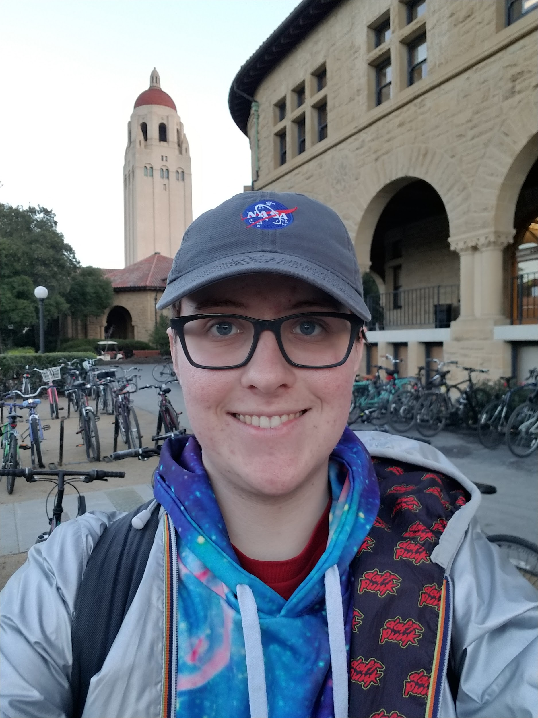
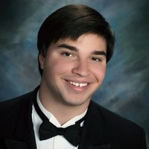
Our Team
Jake Ray
Fiona Hall-Zazueta
Eli Vazquez
David Rathmann-Bloch
Notes:
CLICK ON THE IMAGE ABOVE YOUR NAME AND REPLACE IMAGE WITH YOUR PREFERED PROFILE PIC

Slide 3

New Domain
Improving the frequency, enjoyment, and learning outcomes of class discussions.
Notes:
Didn’t do initial POV in studio

Slide 4
This presentation
Needfinding & POVs
HMWs
Experience Prototypes
Summary

Slide 5
Needfinding II
5 additional interviews
(1 family member and 1 Stanford student)

Slide 6
Participant 8: Caterina
Law professor and mother of two
Frustrated by perceived lack of educational video games for kids
Wanted to keep kids away from violent games and give them something educational

Slide 7
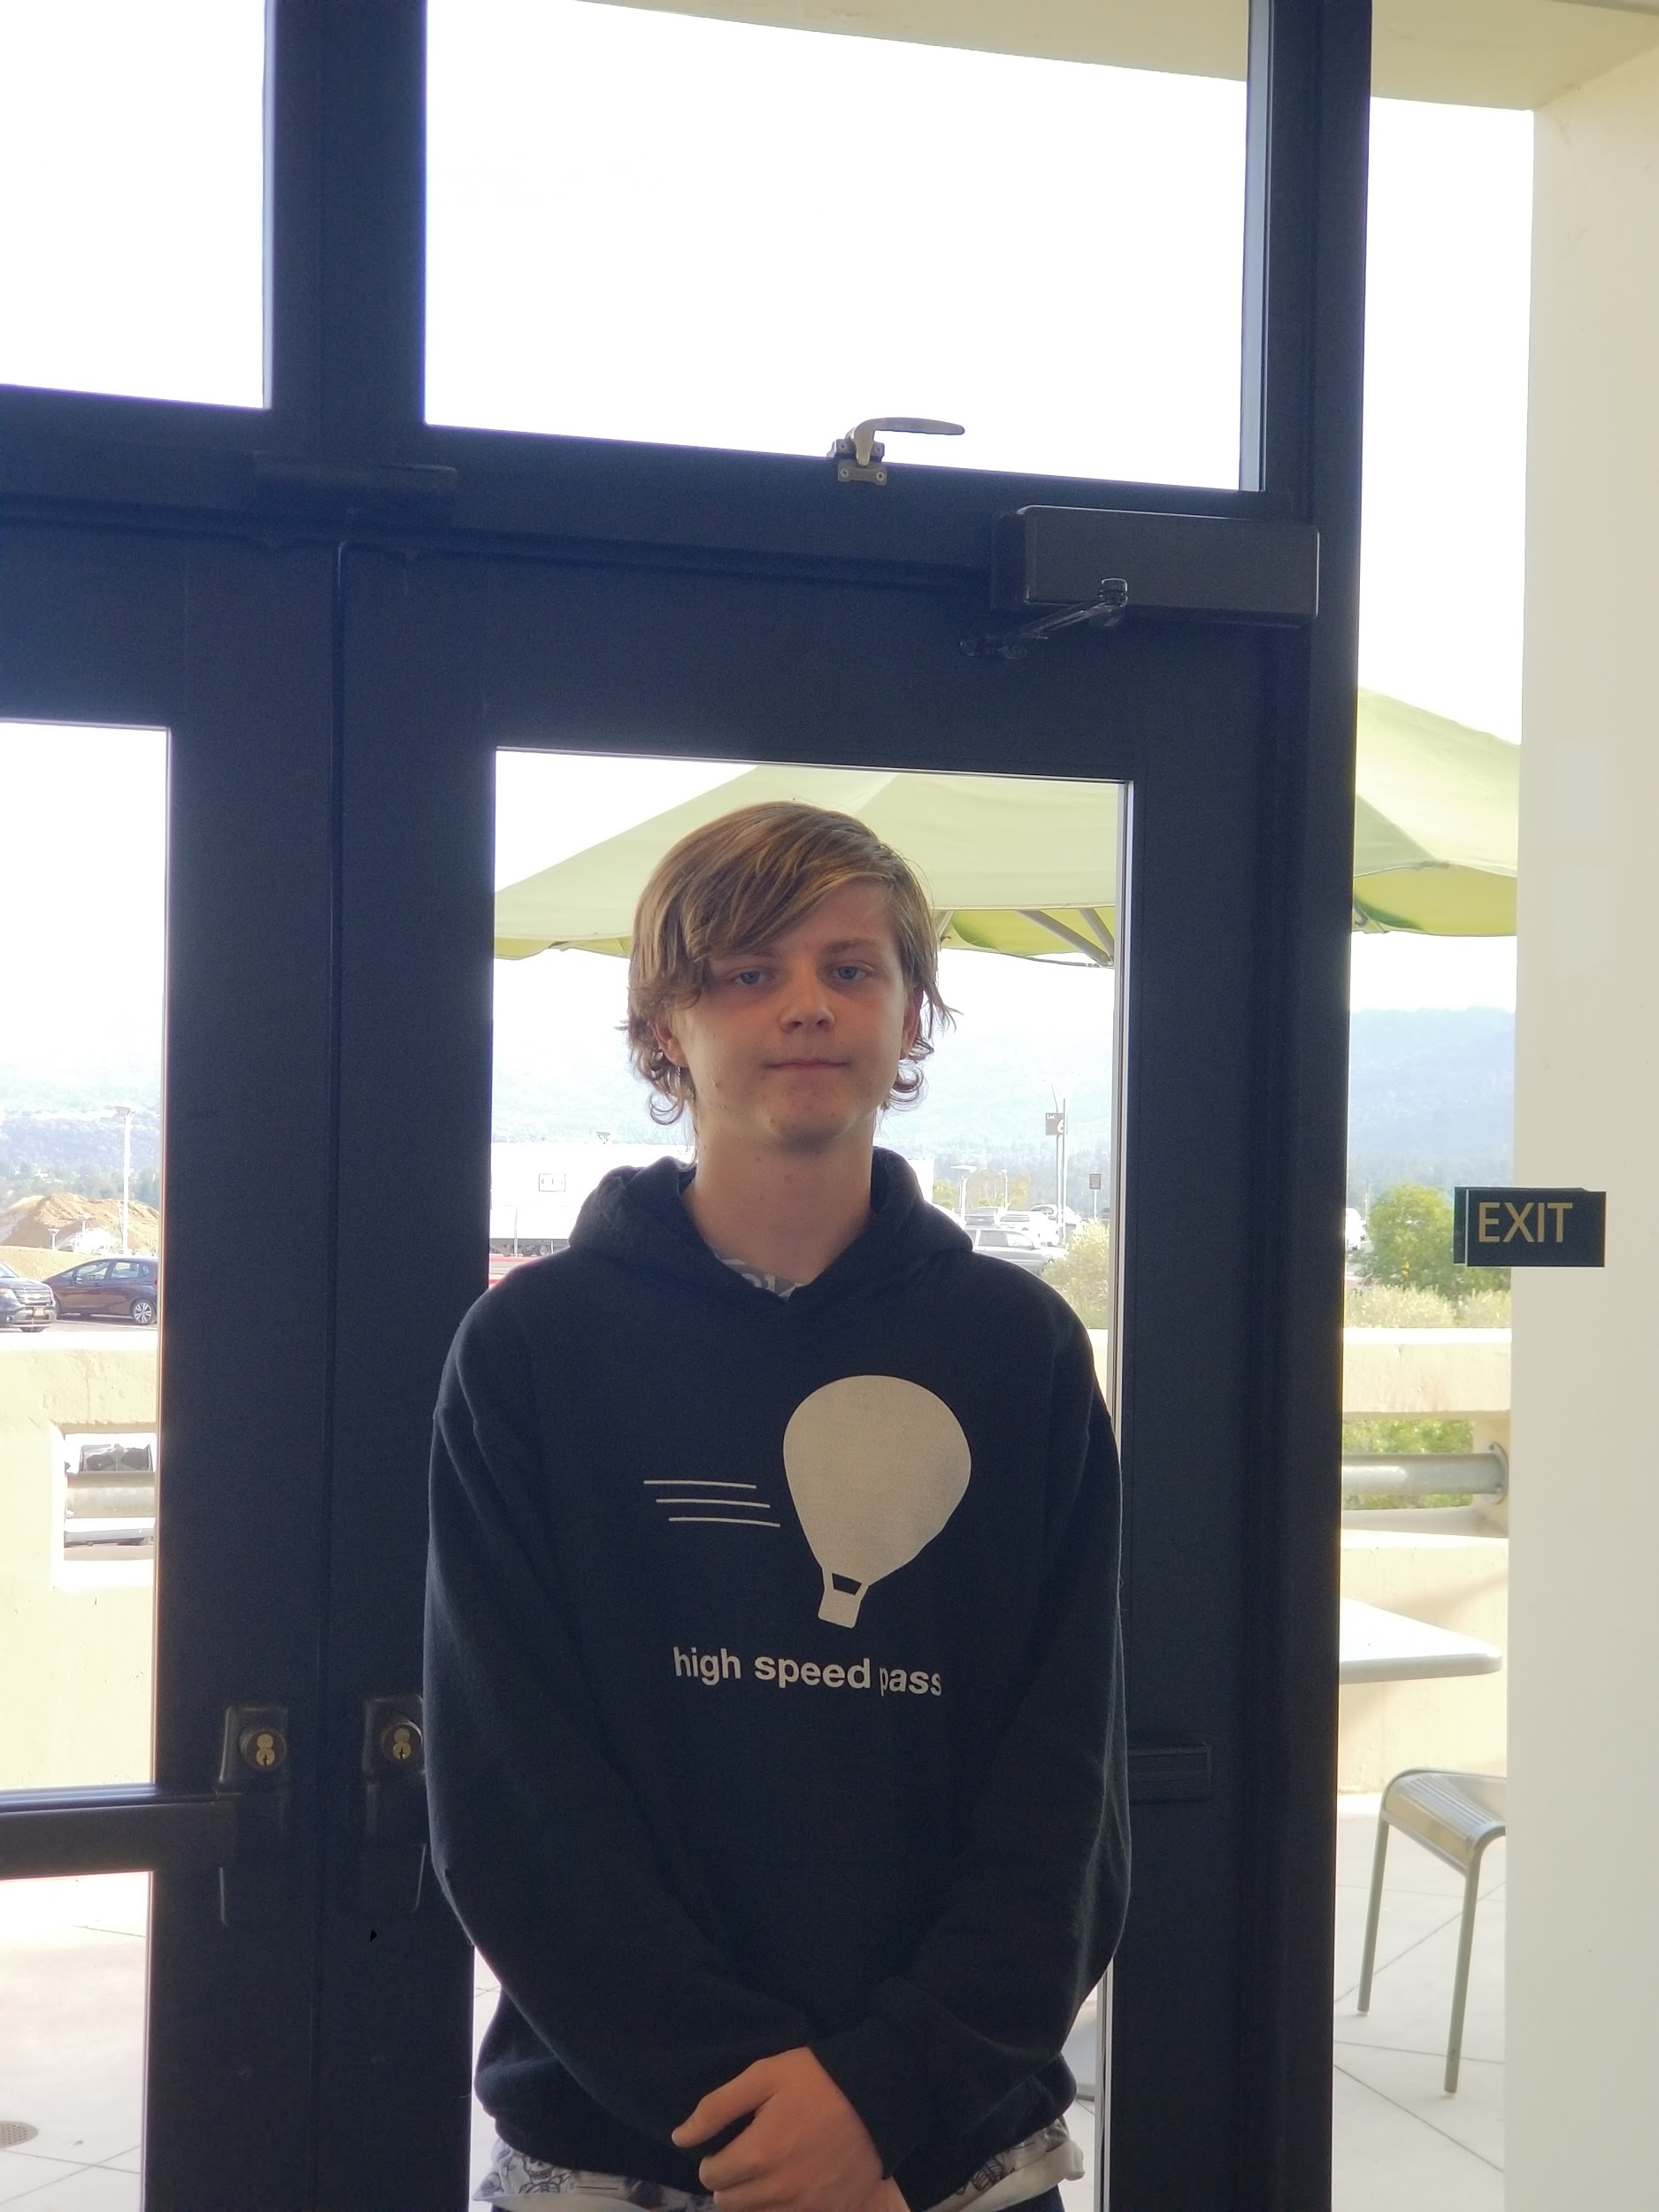
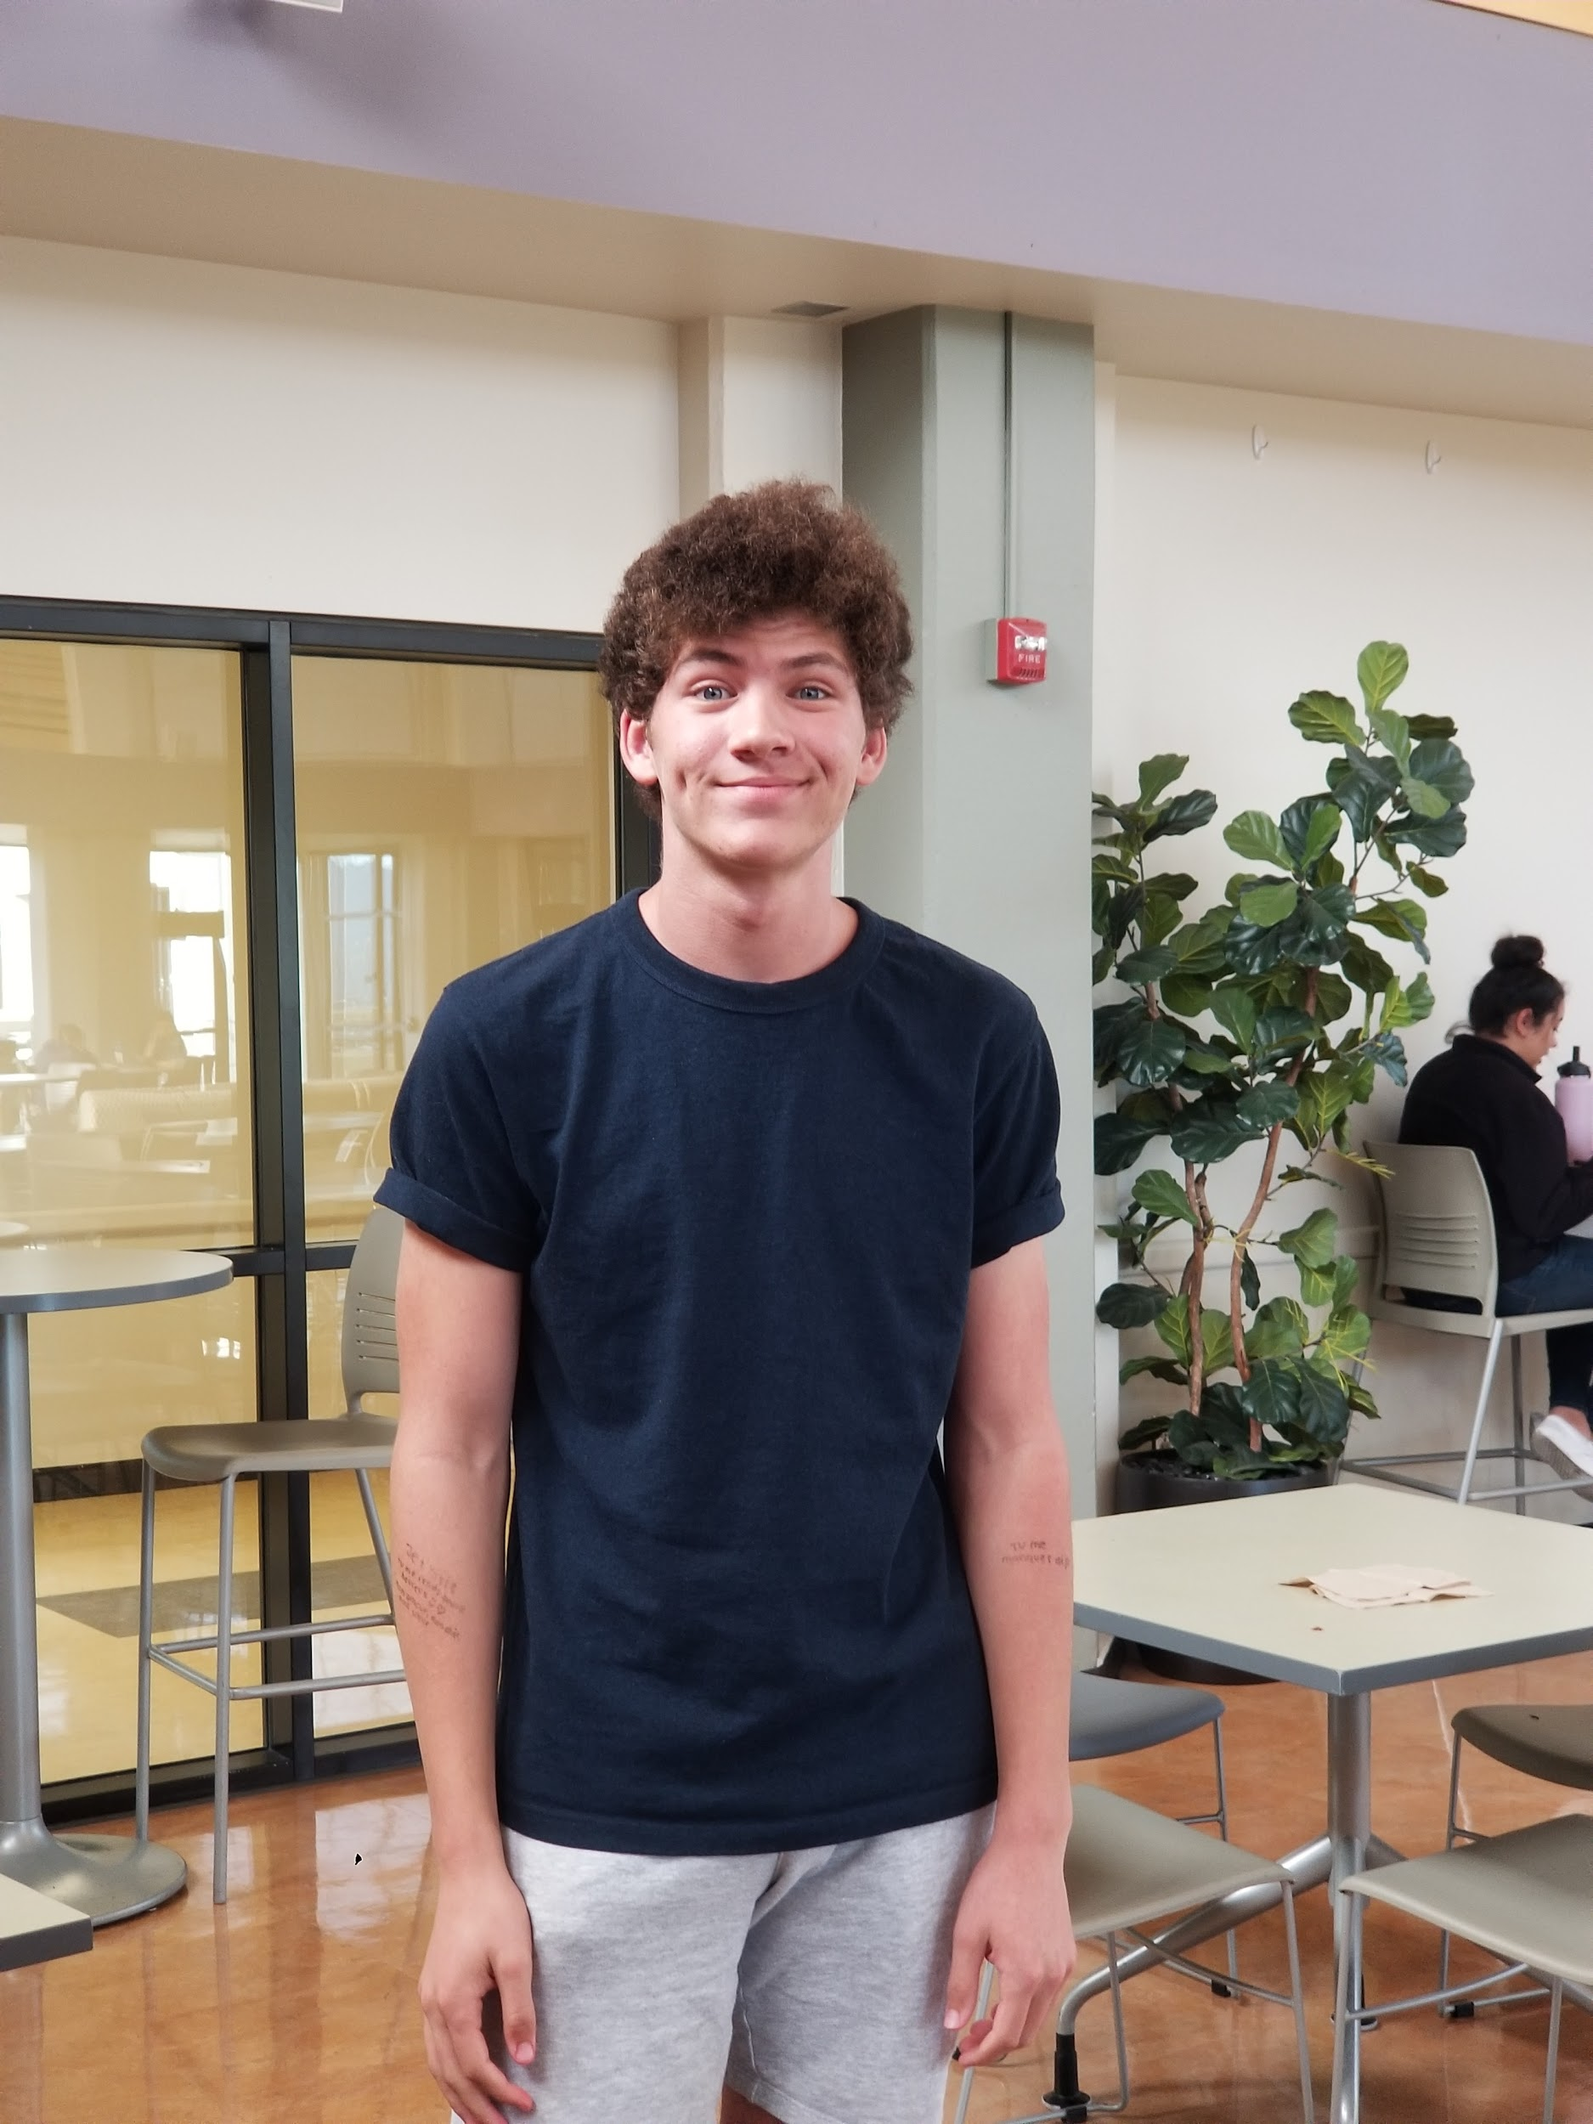
Participants 9 & 10: Joe and Nick
High school juniors enrolled in Middle College at Canada College.
Joe loves both the interaction of in-person classes and the convenience of online classes.
Nick’s film class satisfies him intellectually because of the rich discussions.

Slide 8
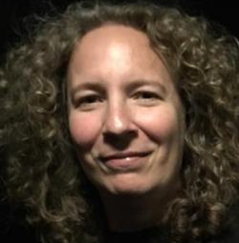
Participant 11: Janice
Professor of fiction and nonfiction storytelling
Takeaways:
Importance of classroom discussion
Camaraderie
Managing students’ shyness
Importance of peer review
Tailoring class to participants

Slide 9
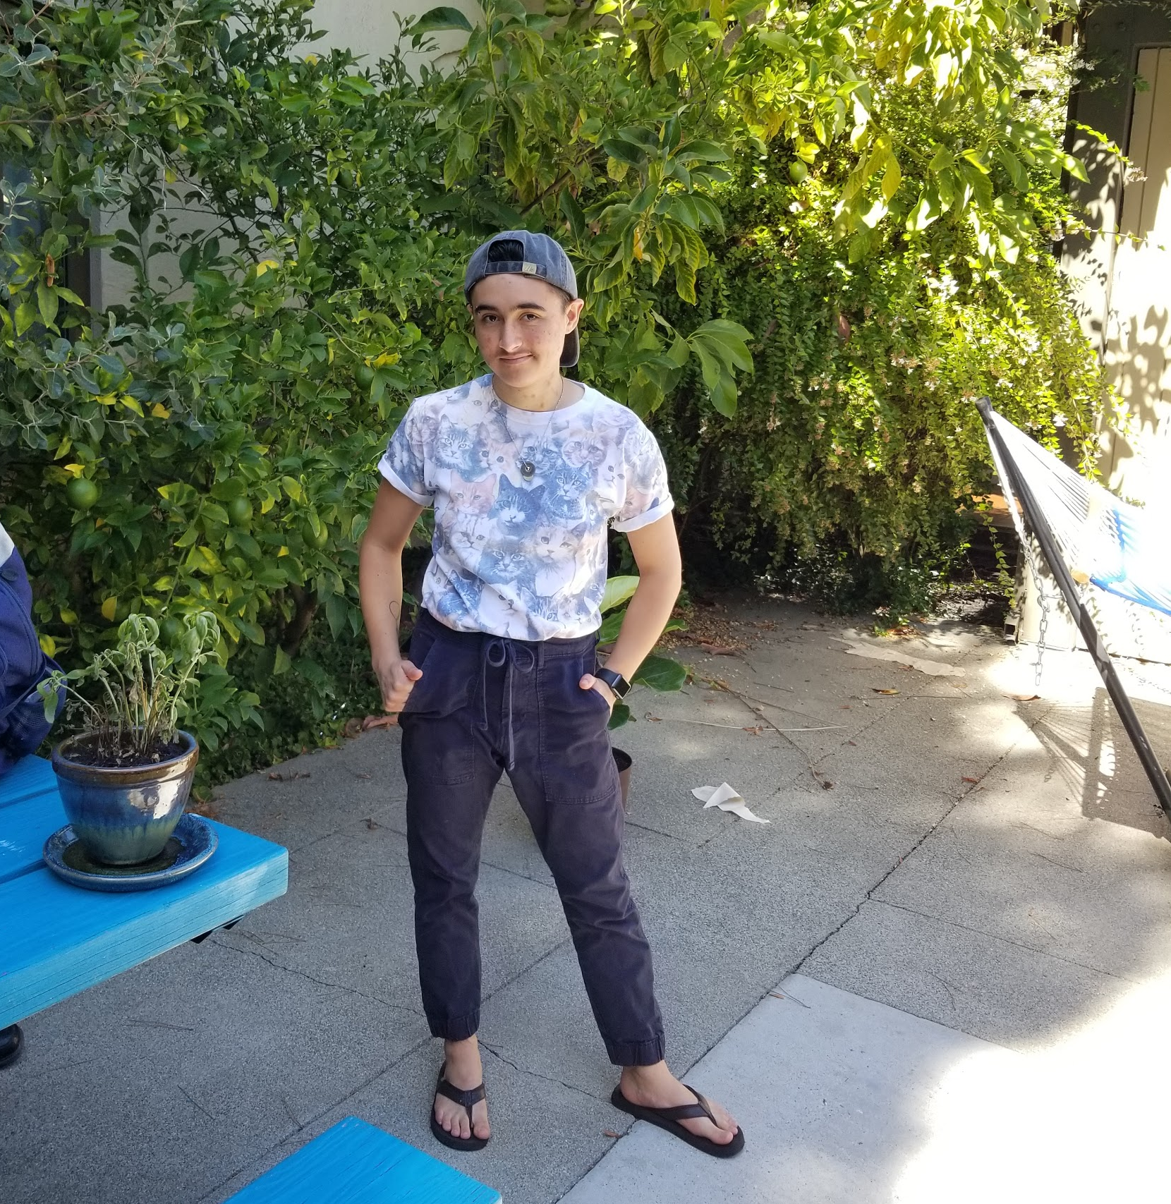
Participant 12: Samuel
4th year Stanford CS undergrad.
Tension: despite being a CS student, their favorite classes are humanities classes, and within CS classes they actually prefer the introductory courses to the higher level ones.
Tension: sometimes wishes for more discussion section, but “hates” adding to schedule

Slide 10
12 POV ideas → 3 POVs
Notes:
Created POVs for all of our interviews from this week and last, though we did not have just one “initial POV” from last section. Then, we picked our three favorites.

Slide 11
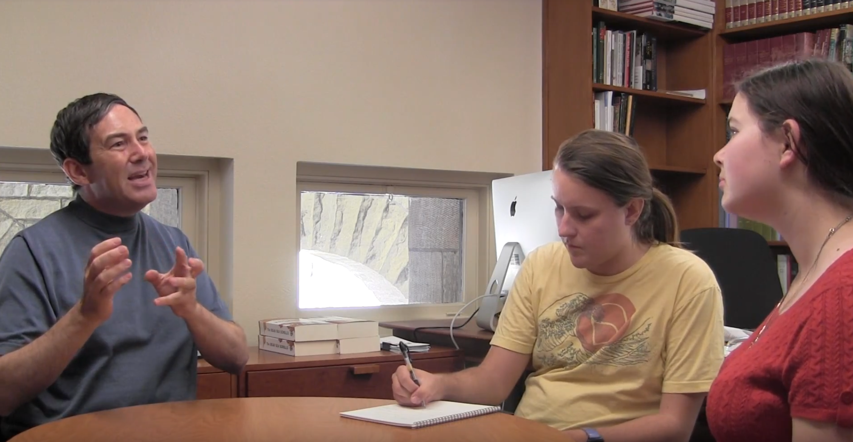
POV 1: Gabriel
We met Gabriel, an experienced humanities professor at Stanford.
We were amazed to find that although he loved the idea of technology in the classroom, he refused to use it because it got in the way of body language.
It would be game-changing if students could interact with their technology without it blocking their body language, or to somehow replace this feedback.
Notes:
“I’m … dependent on my students’ facial expressions, their gestures, their body language. And if they’re all staring into the screen, I lose all of it.”

Slide 12
POV 2: Joe
We met Joe, a motivated high school student taking community college classes through the Middle College program at Canada College.
We were amazed to realize that Joe loved both the interaction of in-person classes and the convenience of online classes.
It would be game-changing to satisfy his needs for classroom interaction and flexible time/location at the same time.

Slide 13
POV 3: Samuel
We met Samuel, a 4th year stanford computer science undergraduate student.
We were interested to find that they preferred introductory courses for their welcoming and energetic culture.
It would be game-changing if higher-level classes could retain that culture.

Slide 14
~40 HMW ideas → 3 HMWs
Notes:
From our top 3 POVs, we generated at least 10-15 HMWs each. We then picked our favorite 3.

Slide 15
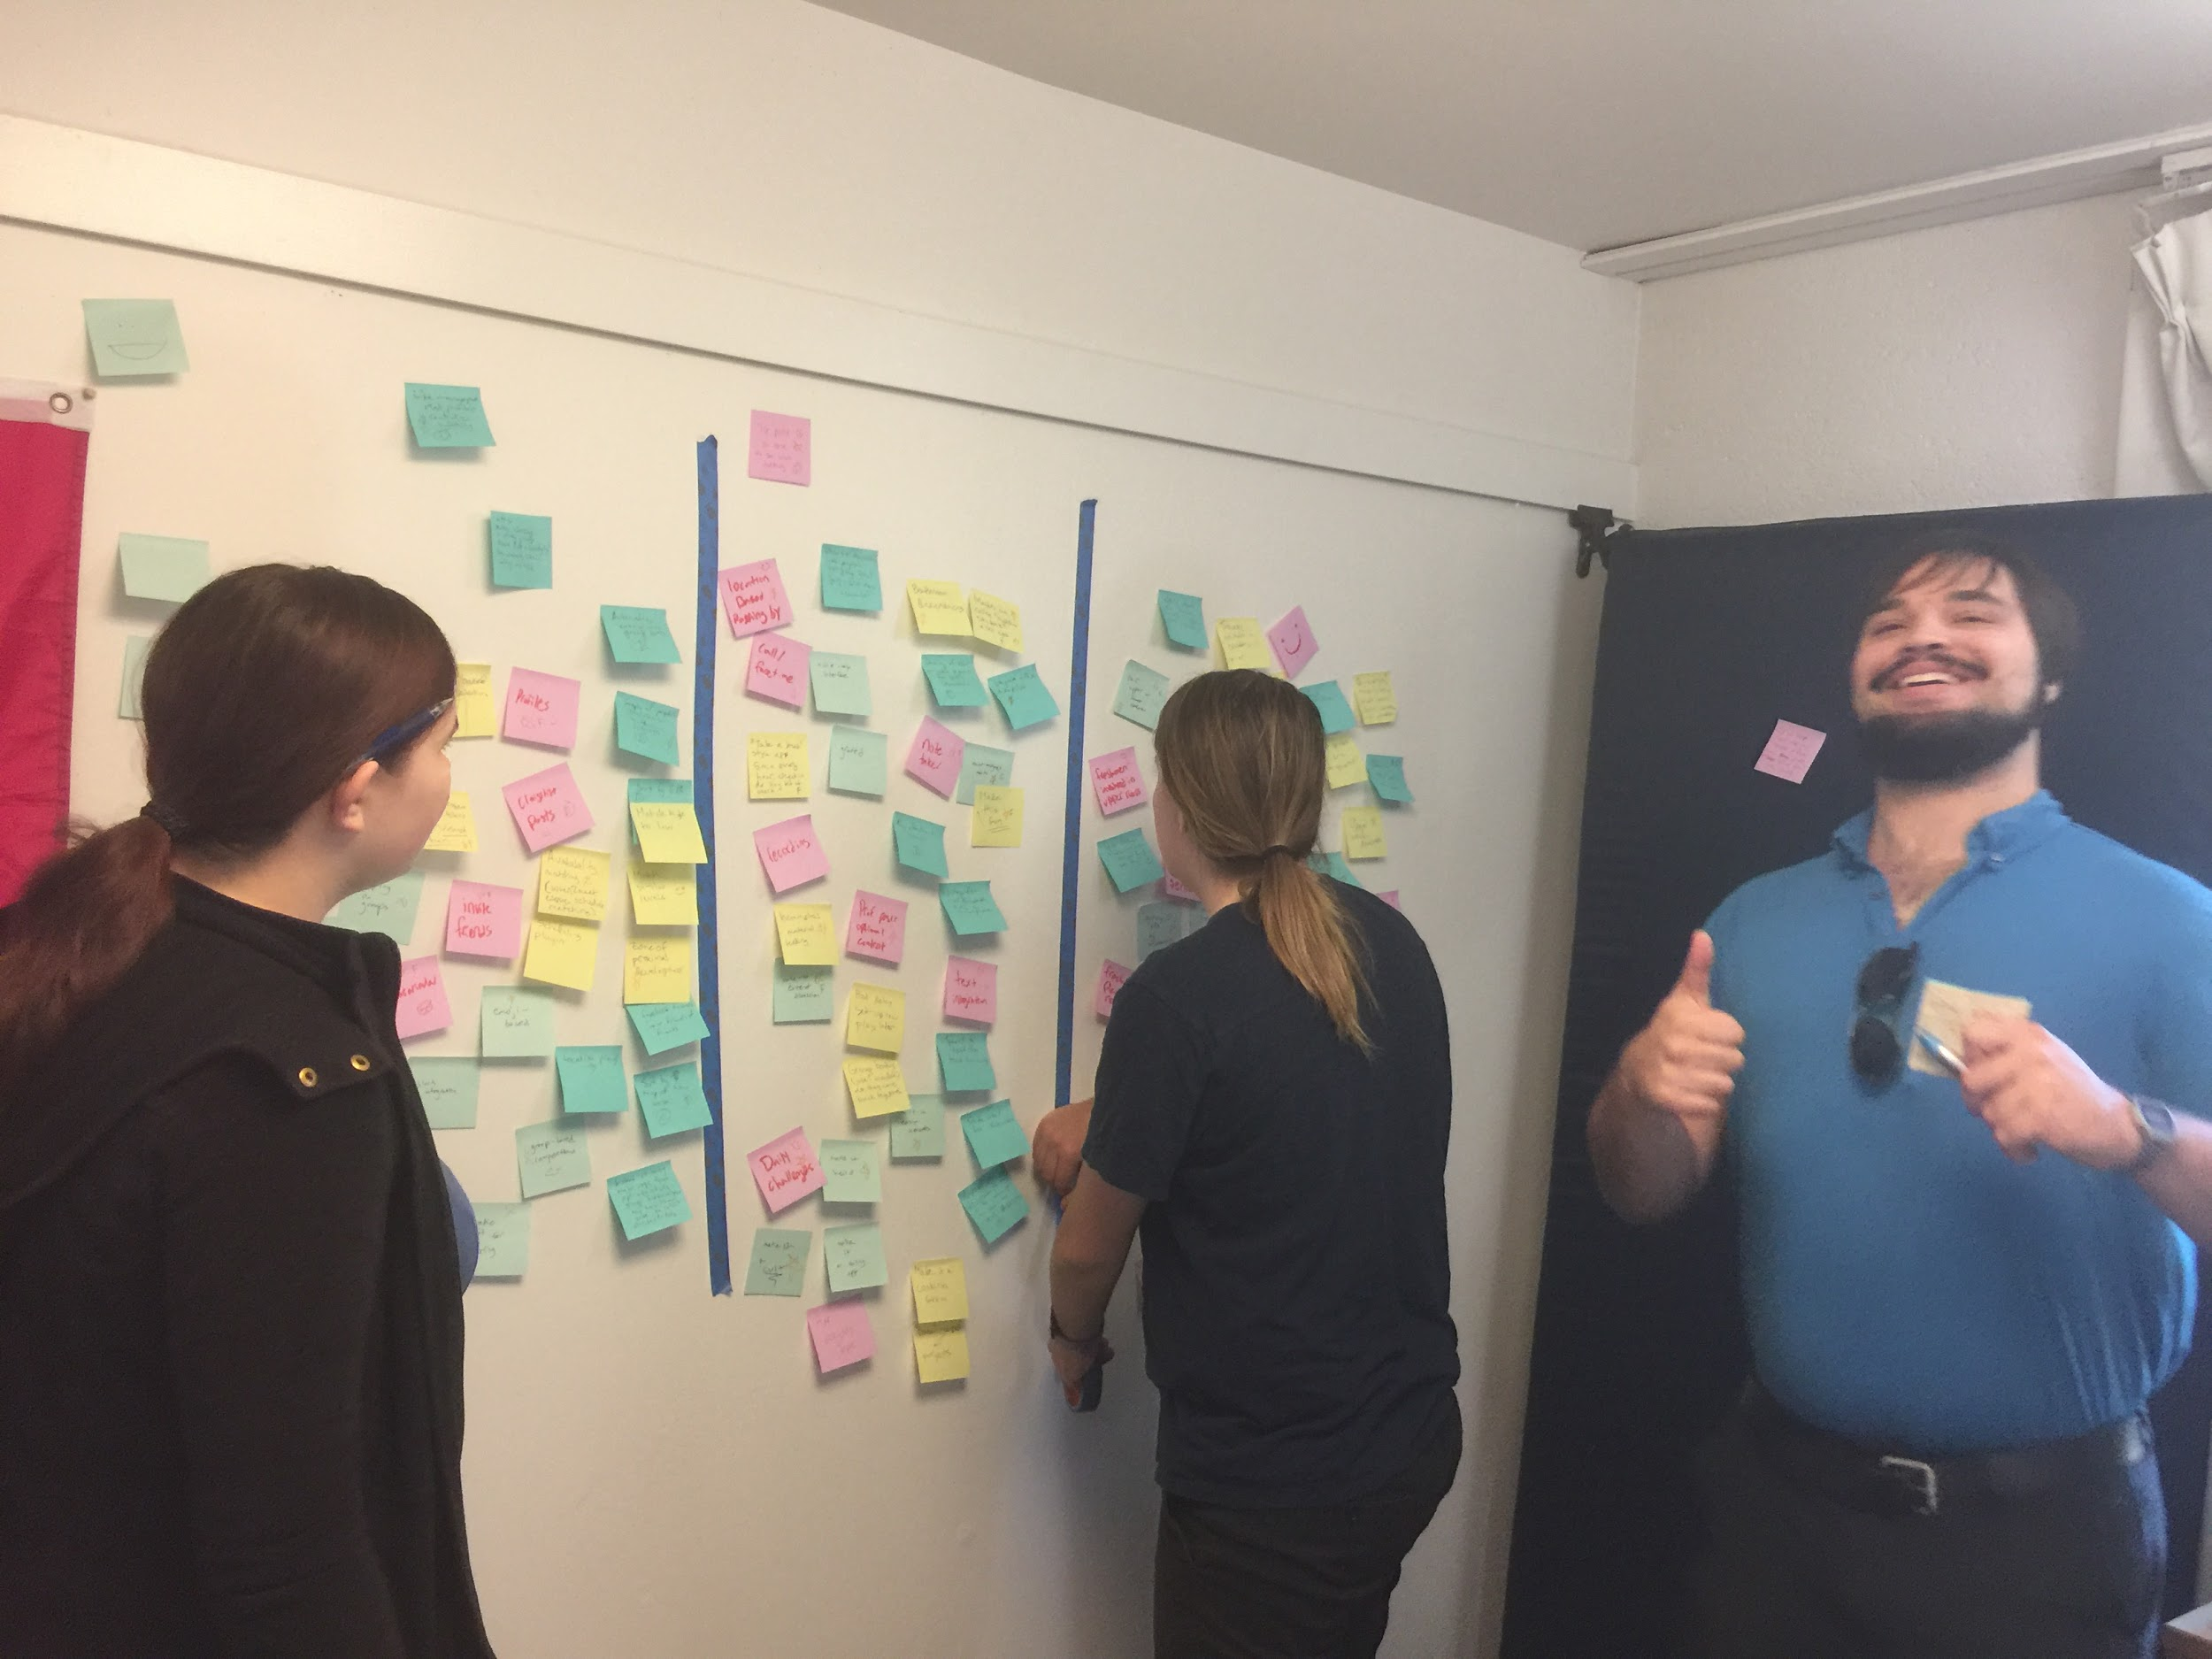
HMW 1: Make finding study groups fun?
Joe (9) →
POV 2 (satisfy interaction need for online courses) →
HMW 1

Slide 16
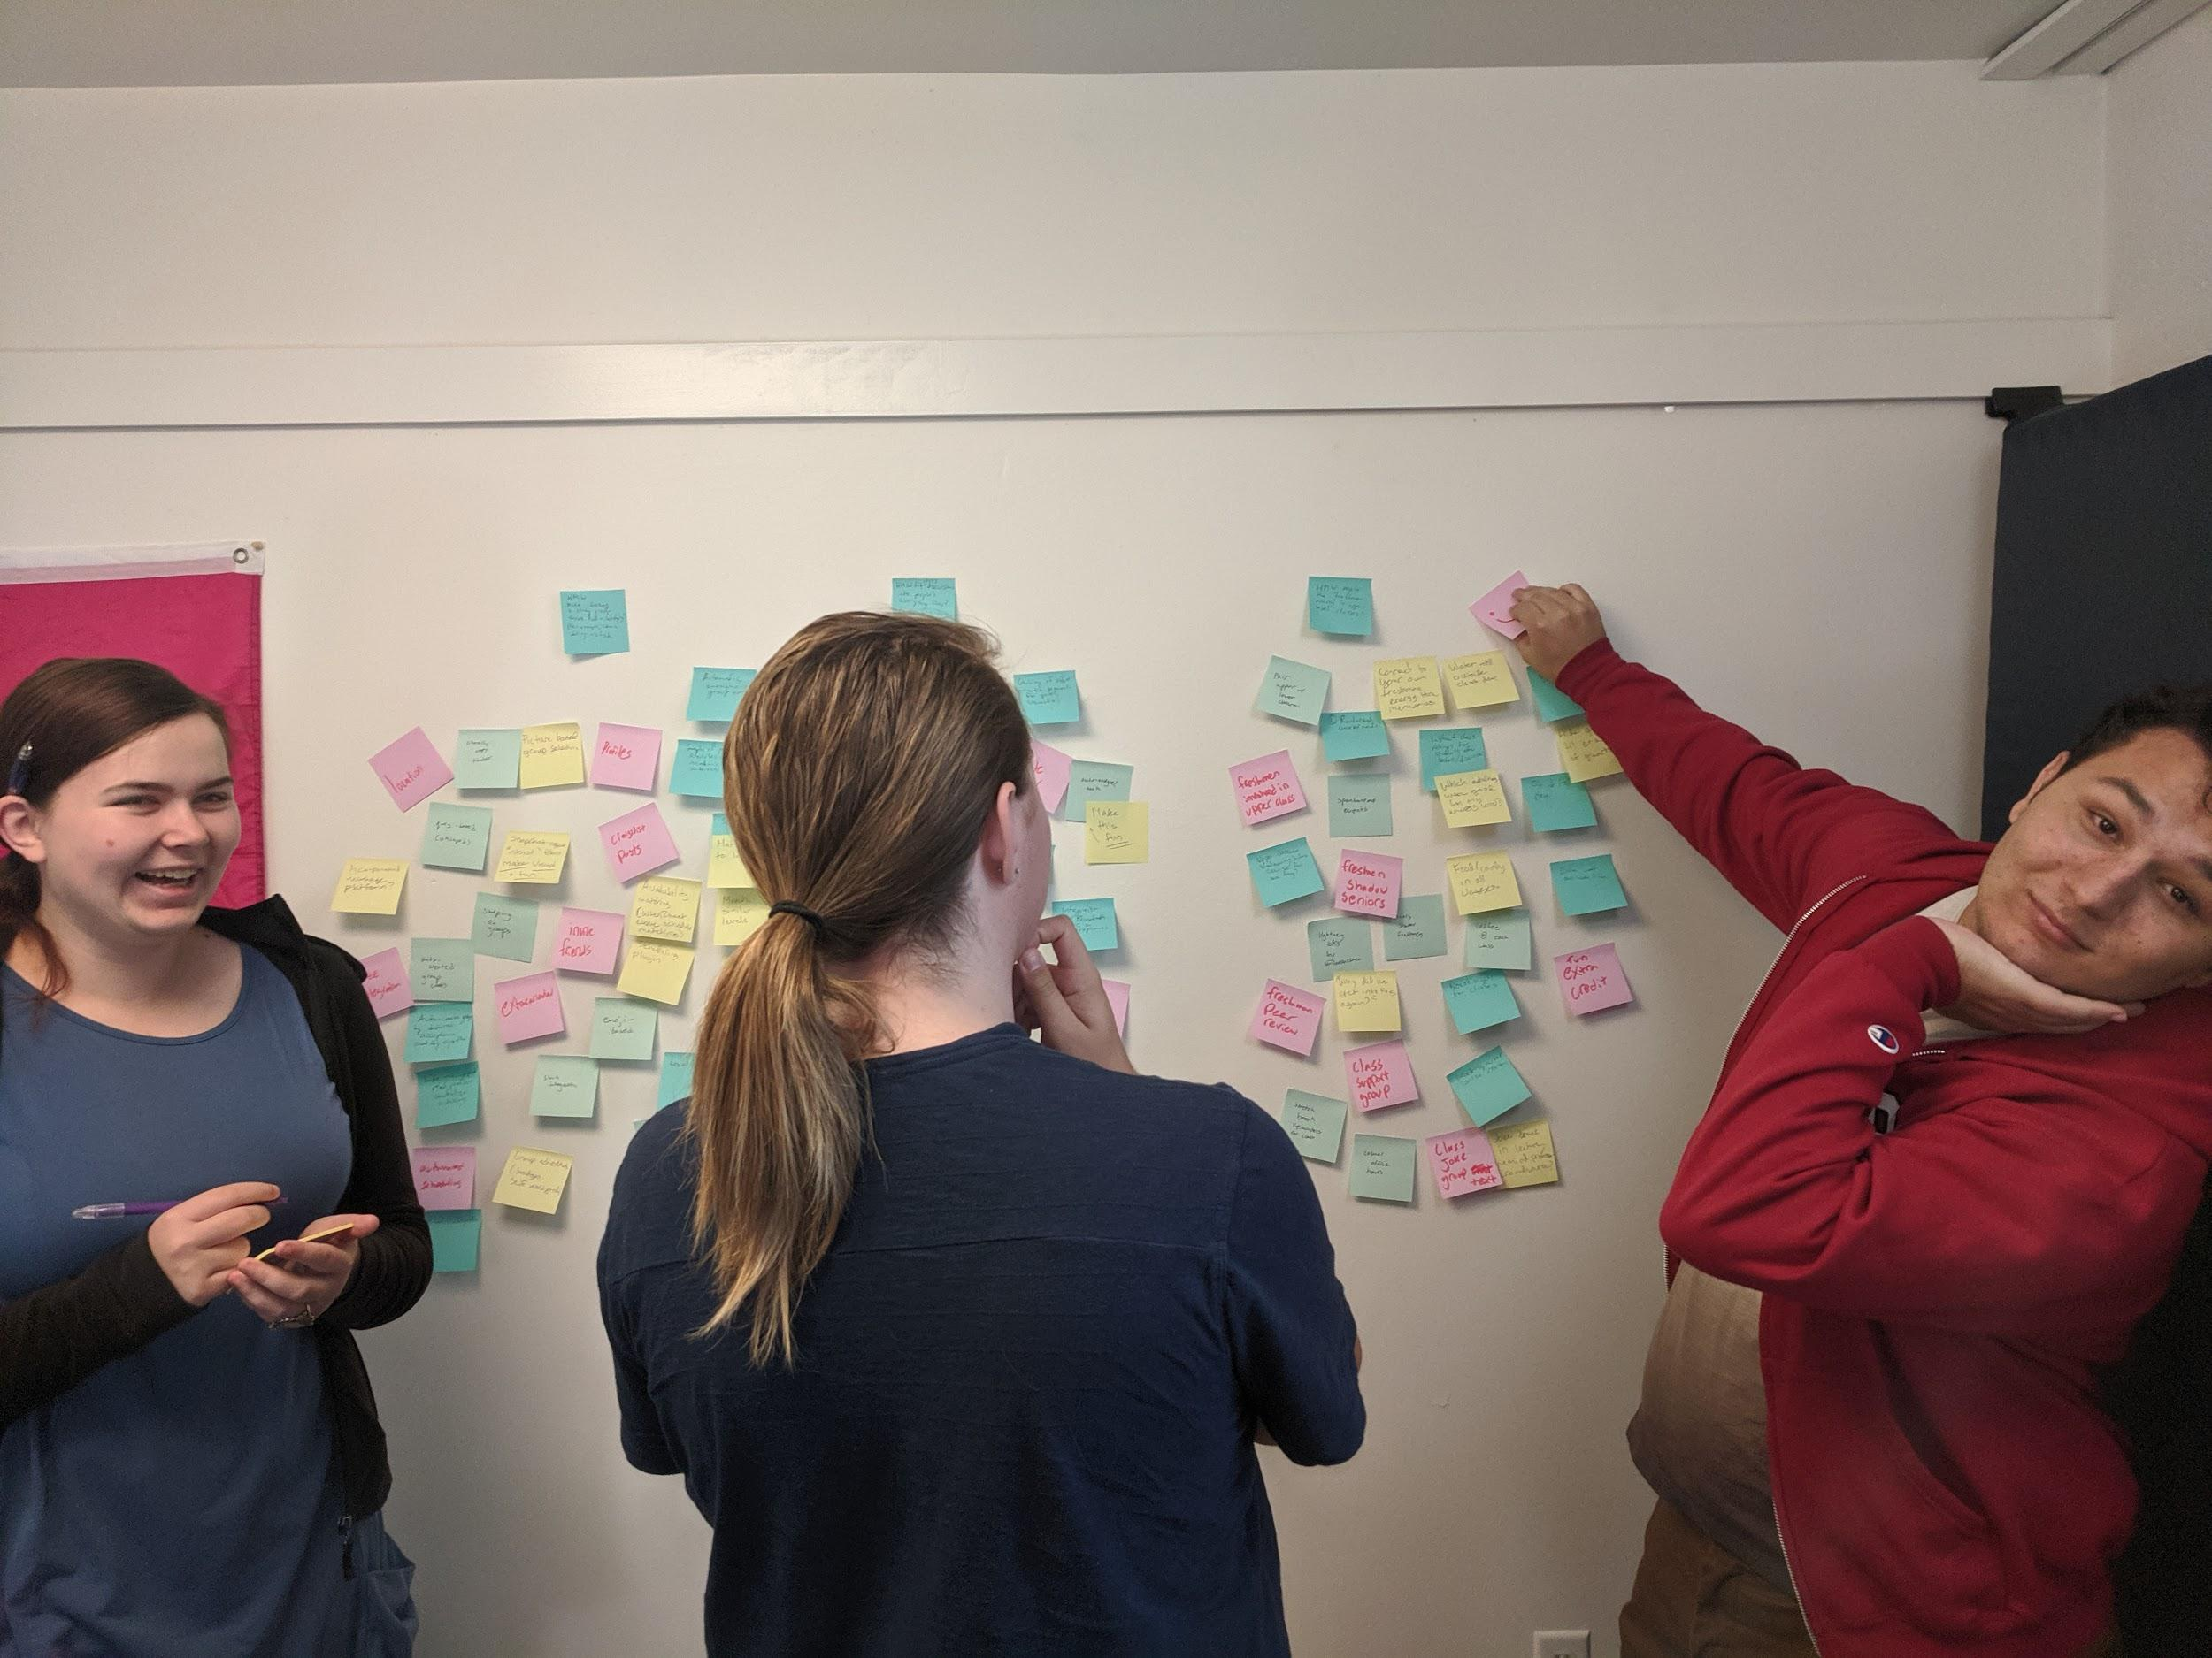
HMW 2: Integrate class discussions into everyday life?
Joe (9) →
POV 2 (satisfy interaction need for online courses)
→ HMW 2

Slide 17
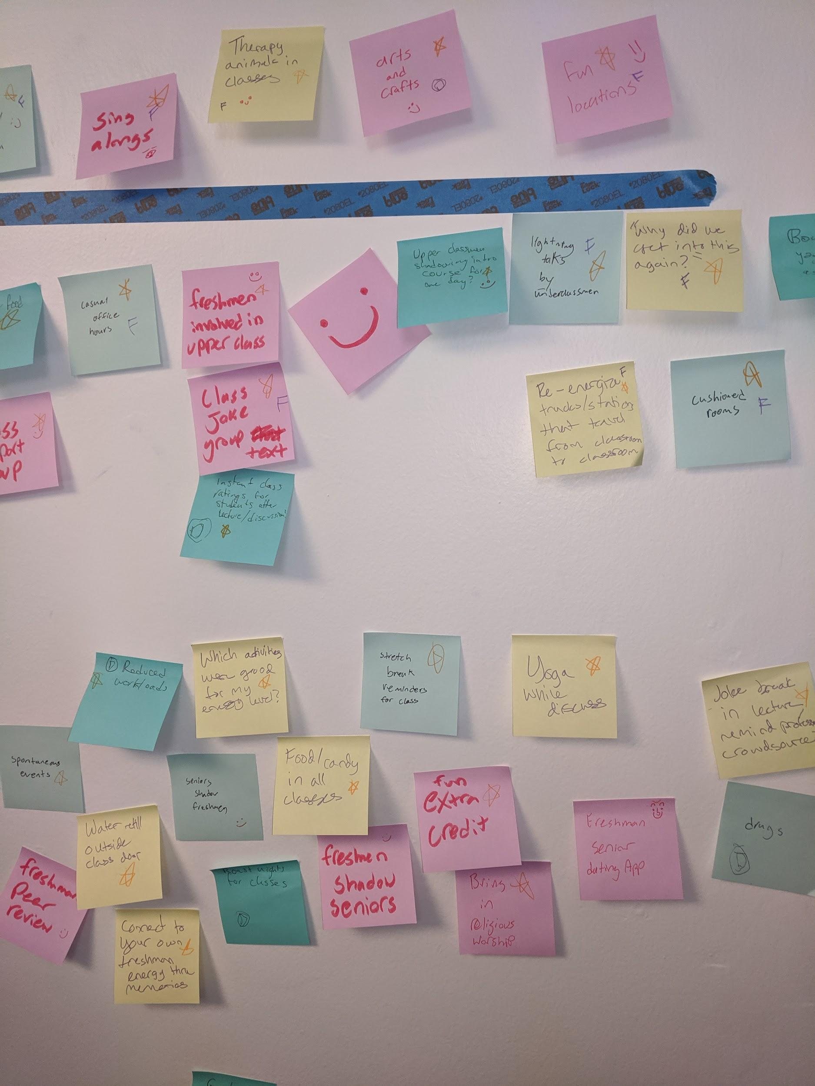
HMW 3: Bring back the freshman energy in high-level classes?
Samuel (12) →
POV 3 (welcoming and energetic culture in upper division)
→ HMW 3

Slide 18
Tech needs to have a clear advantage.
Body Language Problem
Notes:
Even though we carefully brainstormed on Gabriels POV, our HMWs didn’t capture our imaginations.

Slide 19
Experience Prototyping
3 prototype testing sessions with 5 participants (4 Stanford students)

Slide 20
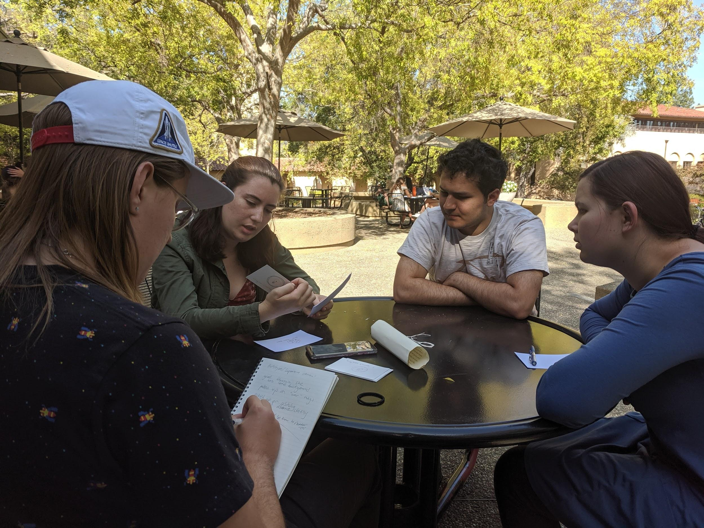
PROTO 1: Badges
Joe (9) →
POV 2 (satisfy interaction need for online courses) →
HMW 1 →
PROTO 1

Slide 21
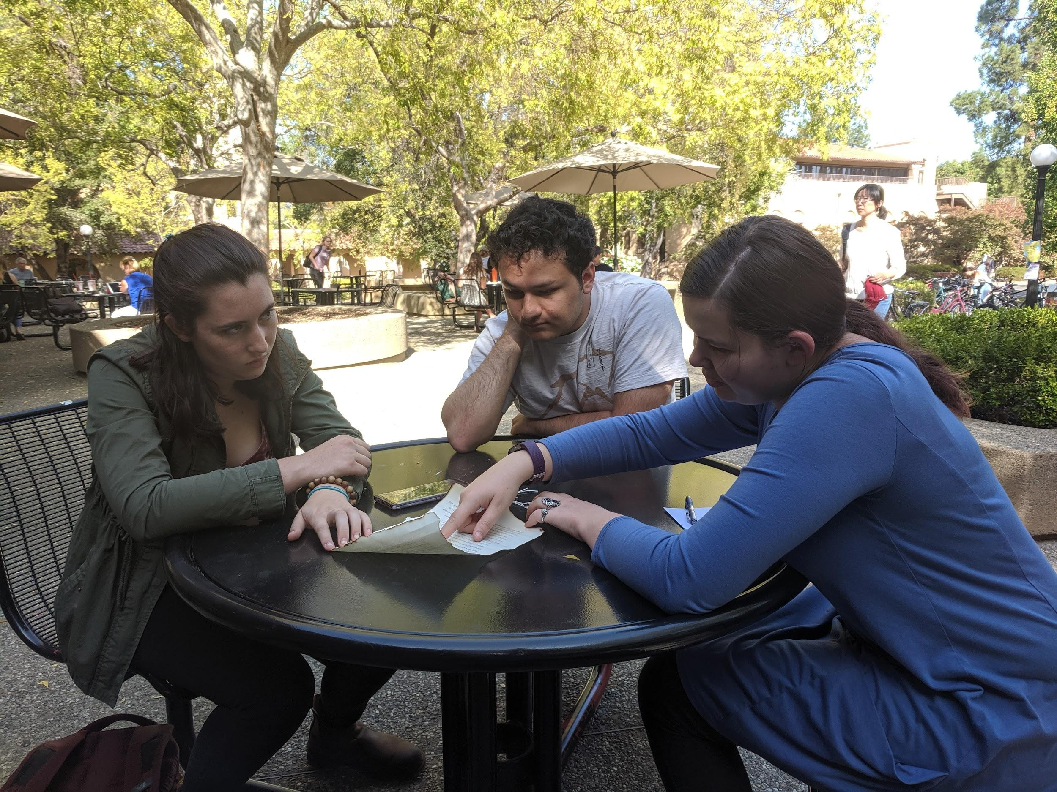
The idea
Persistent digital achievements for discussion or study group participation
Make finding and participating in study groups more fun.
Test using a literature interpretation activity with Heather.

Slide 22
What worked
“Nice reminder of what a good group discussion is.”

Slide 23
What didn’t work
Lack of background knowledge on the activity
Didn’t take the badges seriously
Peer-to-peer aspect was received poorly
Not much more fun

Slide 24
Validity
We assumed this would be more enjoyable & useful

Slide 25
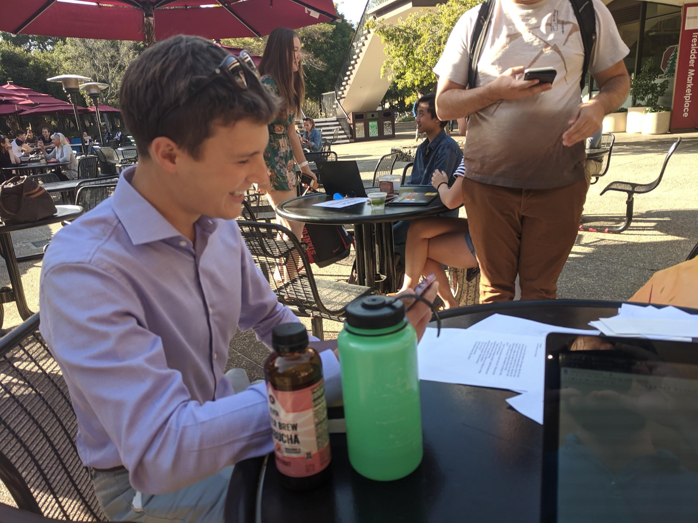
PROTO 2: Remote Discussion
Joe (9) →
POV 2 (satisfy interaction need for online courses) →
HMW 2 →
PROTO 2

Slide 26
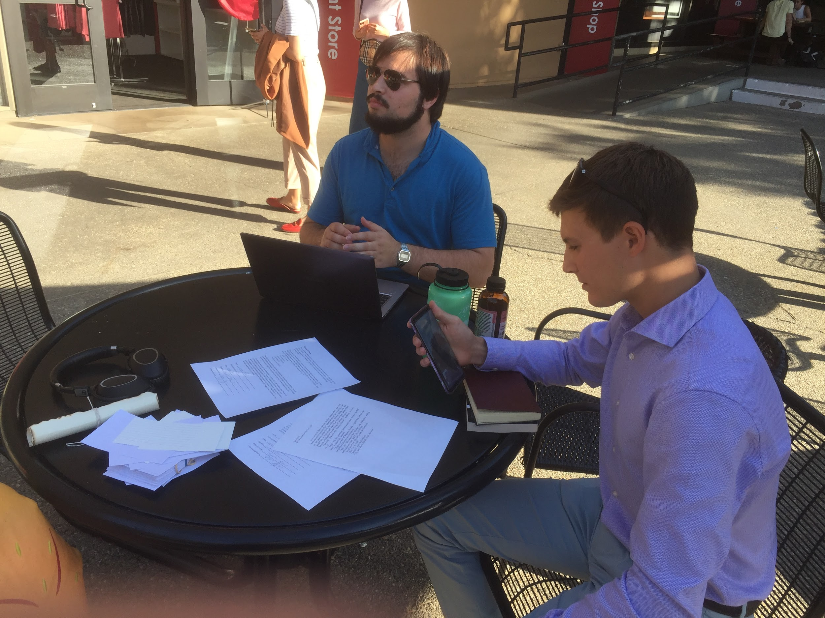
The idea
Reading comprehension/ discussion task done over video call, with one partner going to check mailbox during the call.
Test with Chris and Luke.

Slide 27
What worked
Call quality was excellent
Conversation continued in detail for >7 min
Only a brief interruption when checking the mailbox
Materials on the phone were easy to access
Fun!

Slide 28
What Didn’t
Running out of topics near the end, could have used additional prompting questions
Additional person could have added more perspectives / reduced conversational pressure

Slide 29
Validity
We were skeptical at the beginning
Our hope was that this might work, and it did!

Slide 30
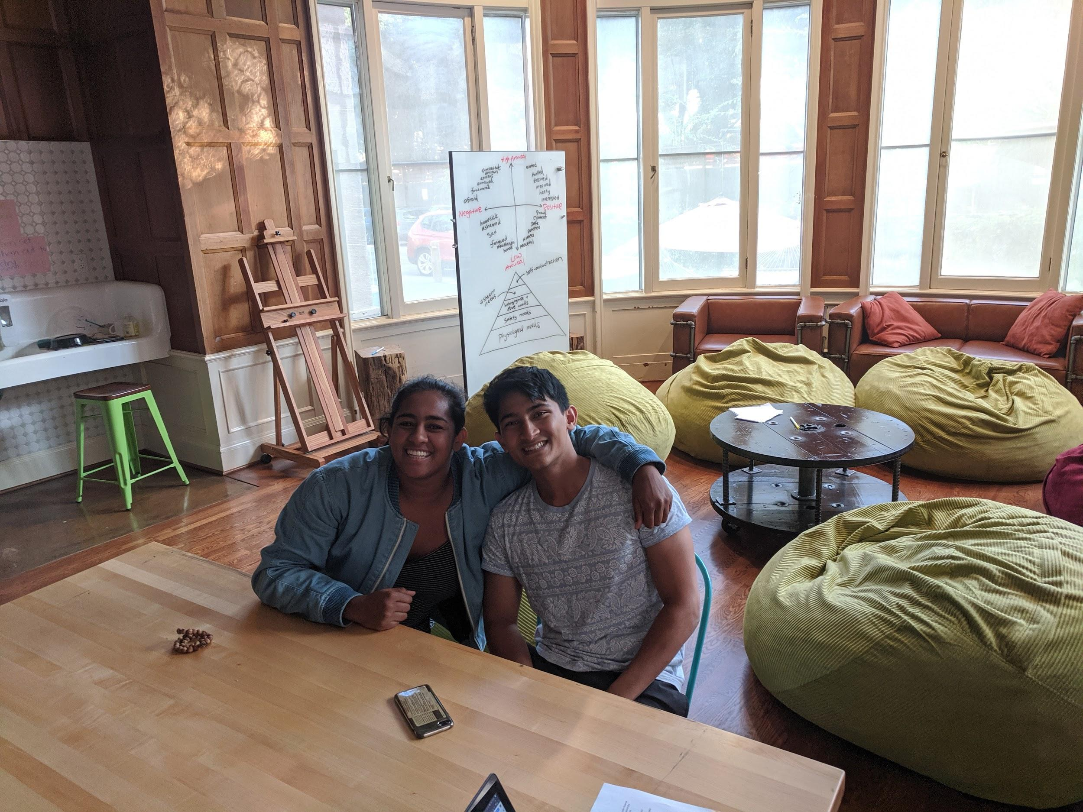
PROTO 3: Freshman-Senior
Samuel (12) →
POV 3 (bring back freshman energy) →
HMW 3 →
PROTO 3

Slide 31
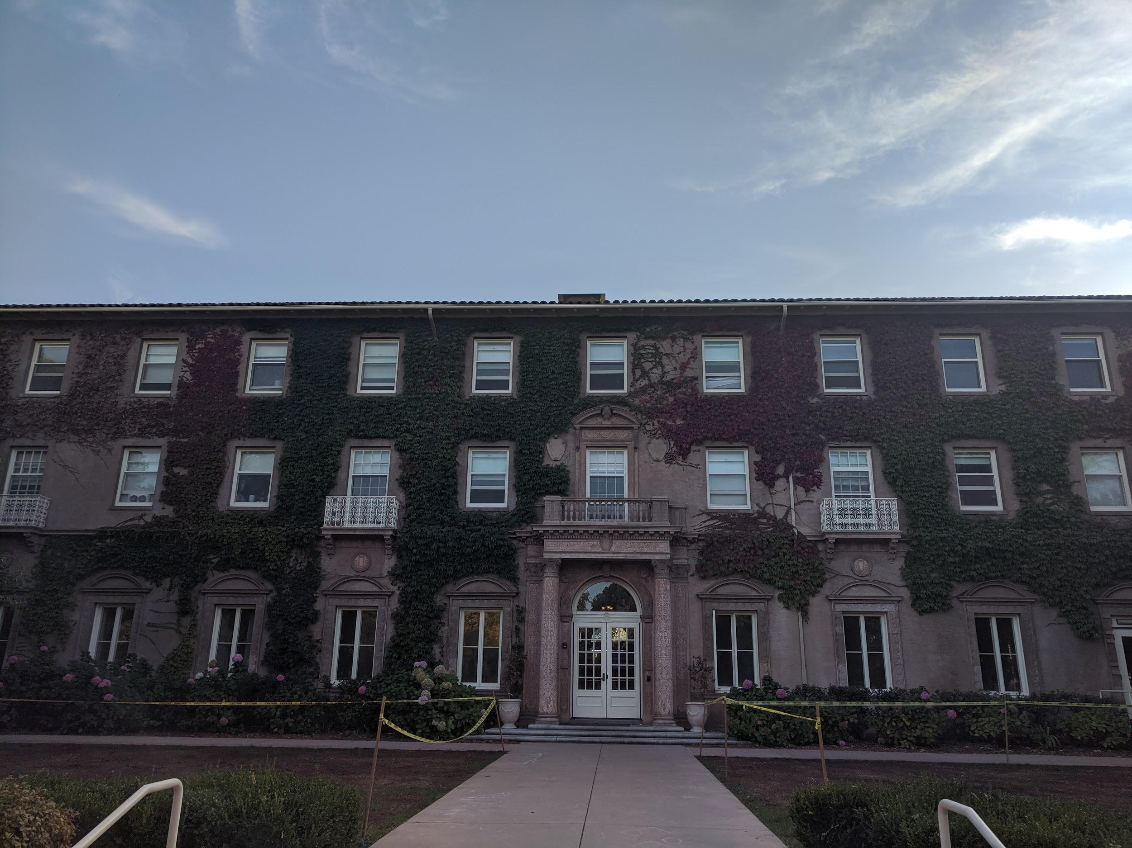
The idea
Arrange a conversation between a freshman (Lim) and a senior (Kamaria)
Make both feel more welcomed
Re-energize academics

Slide 32
What worked
Freshman and senior both felt energized
Conversation was enjoyable
Appreciated the activity
Would continue longer
Would meet up again

Slide 33
What Didn’t
Senior turned out to be RA, so she already regularly interacts with freshmen
Would things have gone differently otherwise?

Slide 34
Validity
Lots of promise!

Slide 35
Solution
Discussion Badges need refinement
Freshman-Senior Meetups and Ad-Hoc Remote Discussions both seem promising!

Slide 36
Summary
13 diverse interviews
12 POV ideas → 3 POVs
~40 HMW ideas → 3 HMWs
3 Experience Prototypes → 2 solution ideas

Slide 37


